Slide 1
Mobile Road Weather Measurements
Taisto Haavasoja, CEO
Presented at ITS Finland – Verkostopäivä
24.08.2017
Inventive Measuring – Ingenious Evaluation

Slide 2
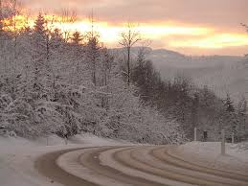

Challenges in Winter Maintenance
Road surface slippery?
More salt needed?
Are roads safe for driving?
Information to road users
Optimizing operations
How to collect weather data effectively?
Sustaining ecology and economy
Less salts and chemicals

Slide 3
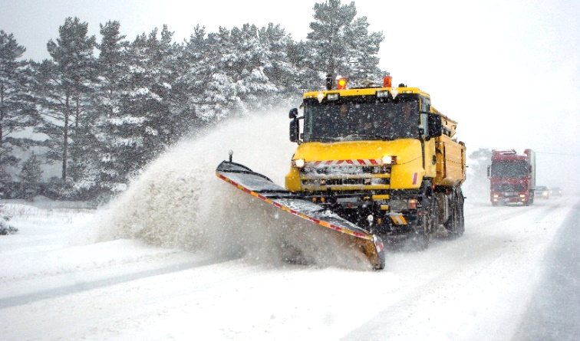
Our Solution
roadweather.online

Slide 4
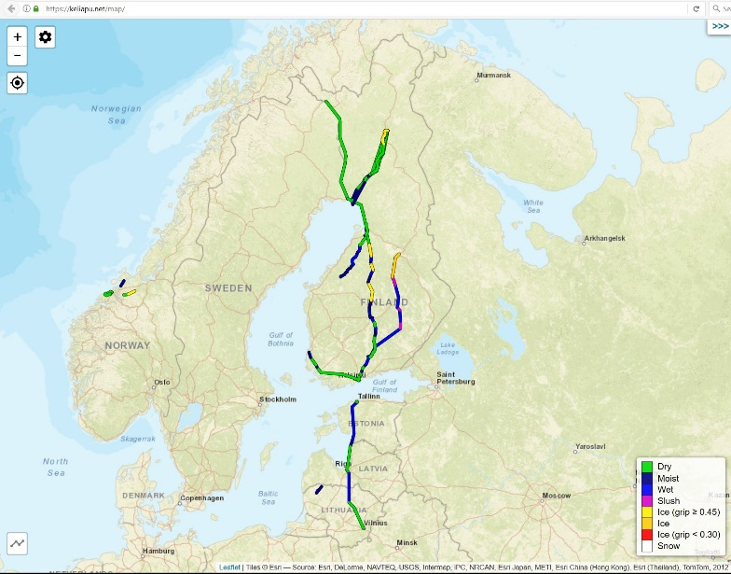
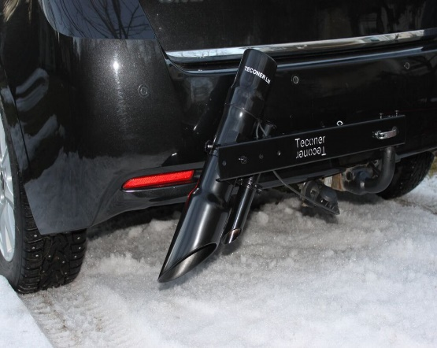
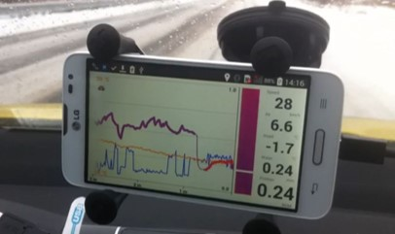
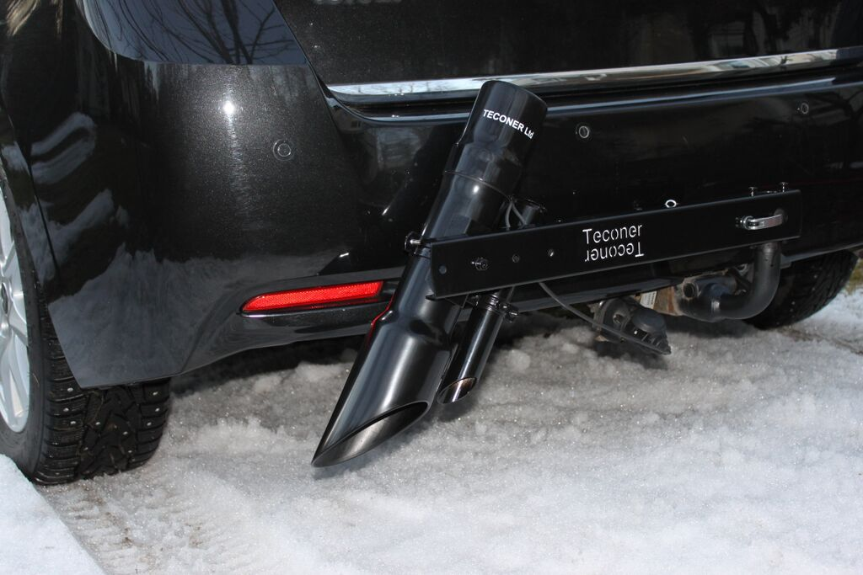
Mobile Road Condition Measurement
System for collecting mobile weather data
Map service to support decision making
Notes:
Kuinka tuotteenne/palvelunne ratkaisee ongelman tai haasteen?

Slide 5
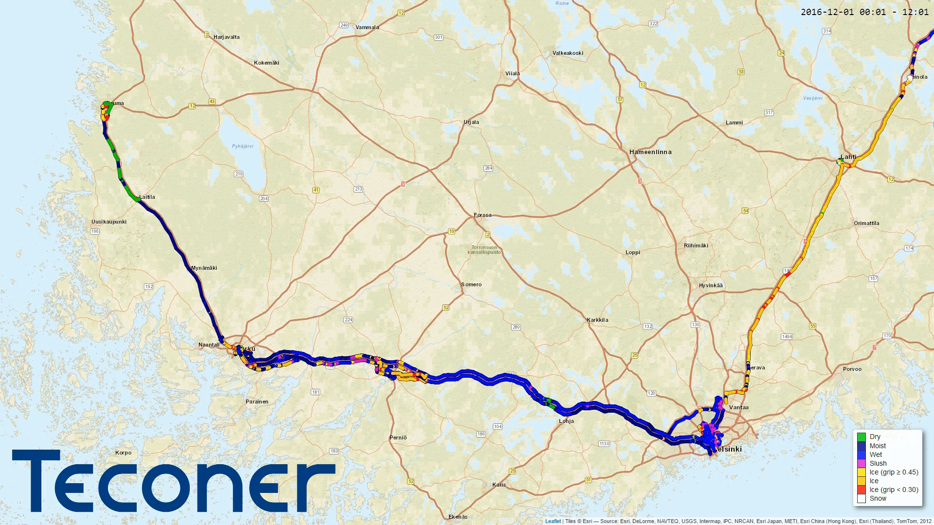
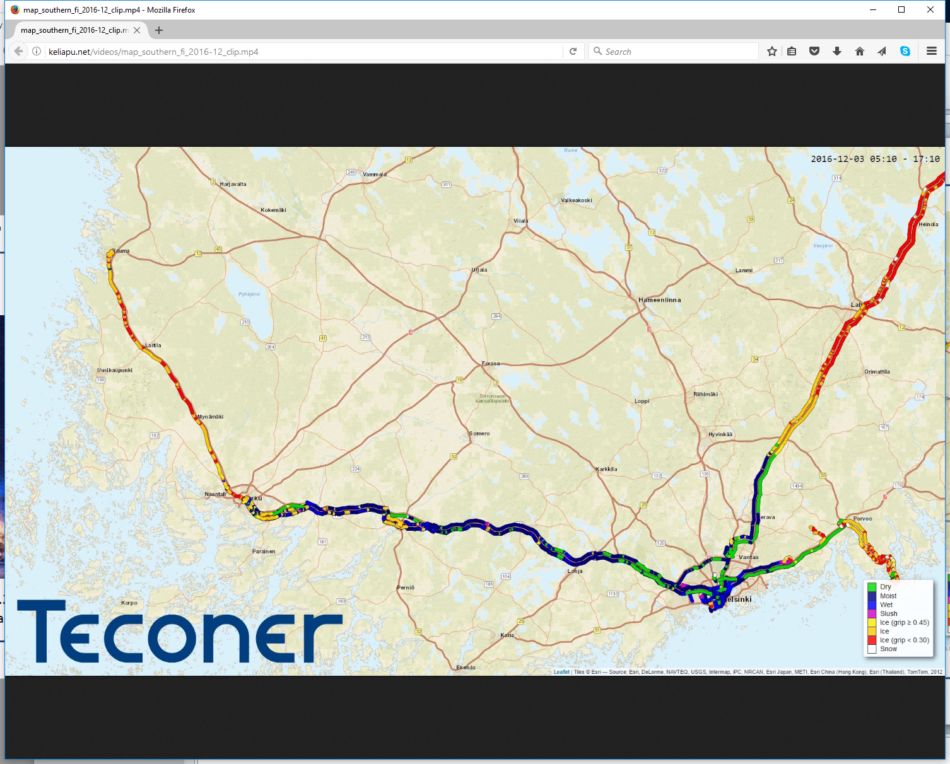

Slide 6
Mobile vs. Fixed Road Weather Stations
Property | Fixed RWS | Mobile measurements
Timeliness | Good | Poor
Spatial coverage | Poor | Good
Cost | Expensive | Economic
Maintenance | Expensive | Low cost
Information to drivers | Poorly applicable | Useful

Slide 7
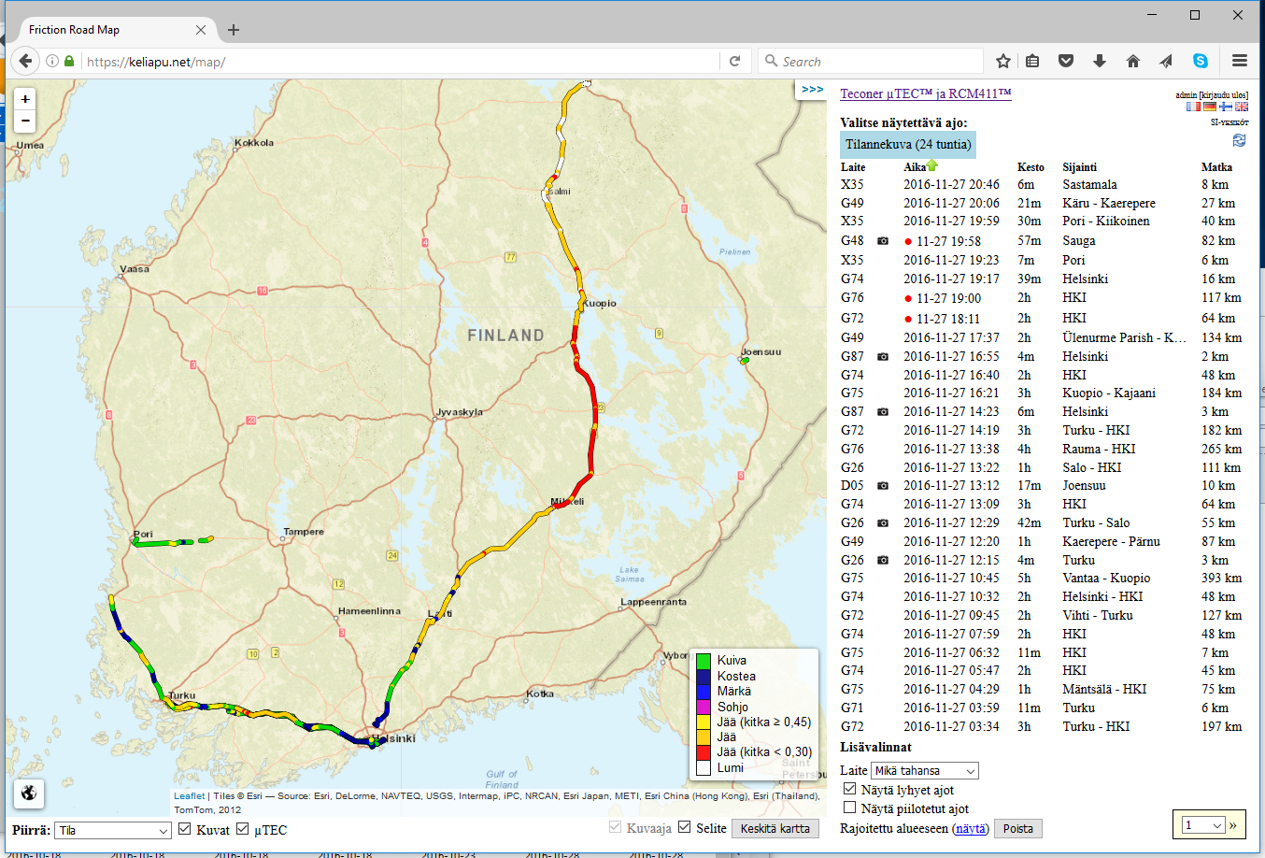
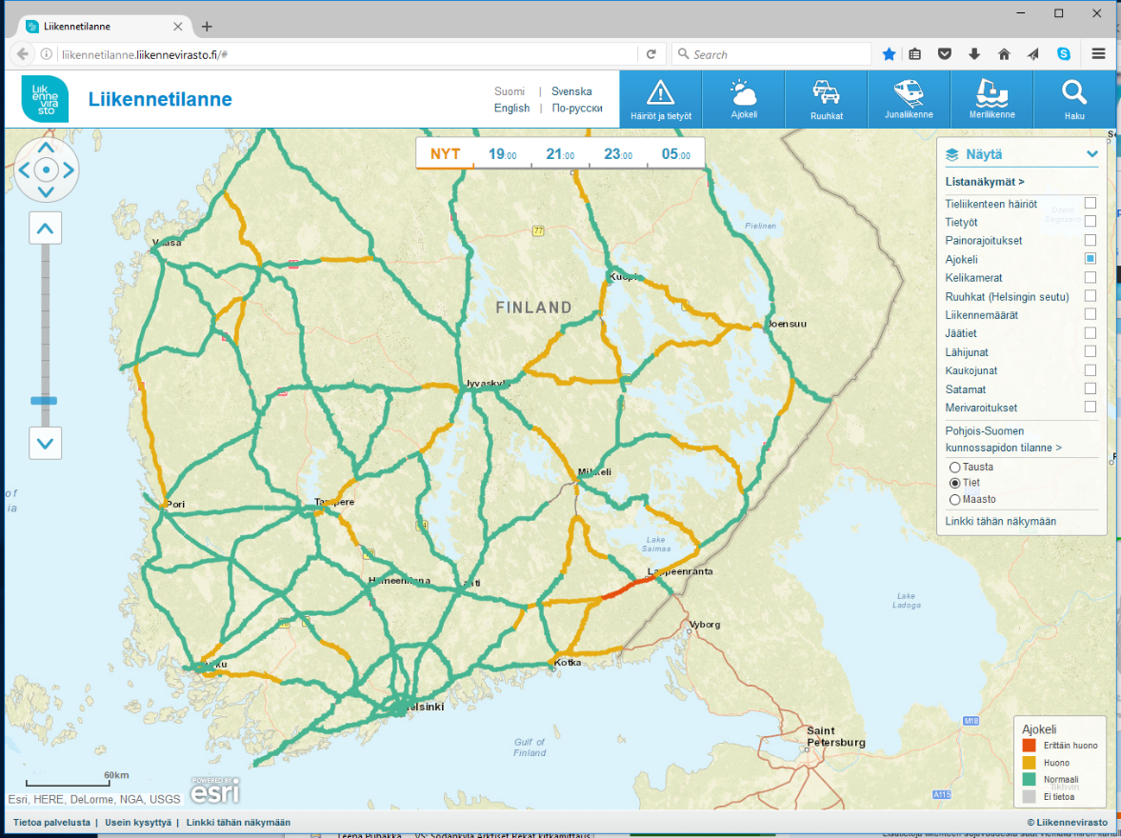
Traffic Conditions: Driving Condition Now

Slide 8
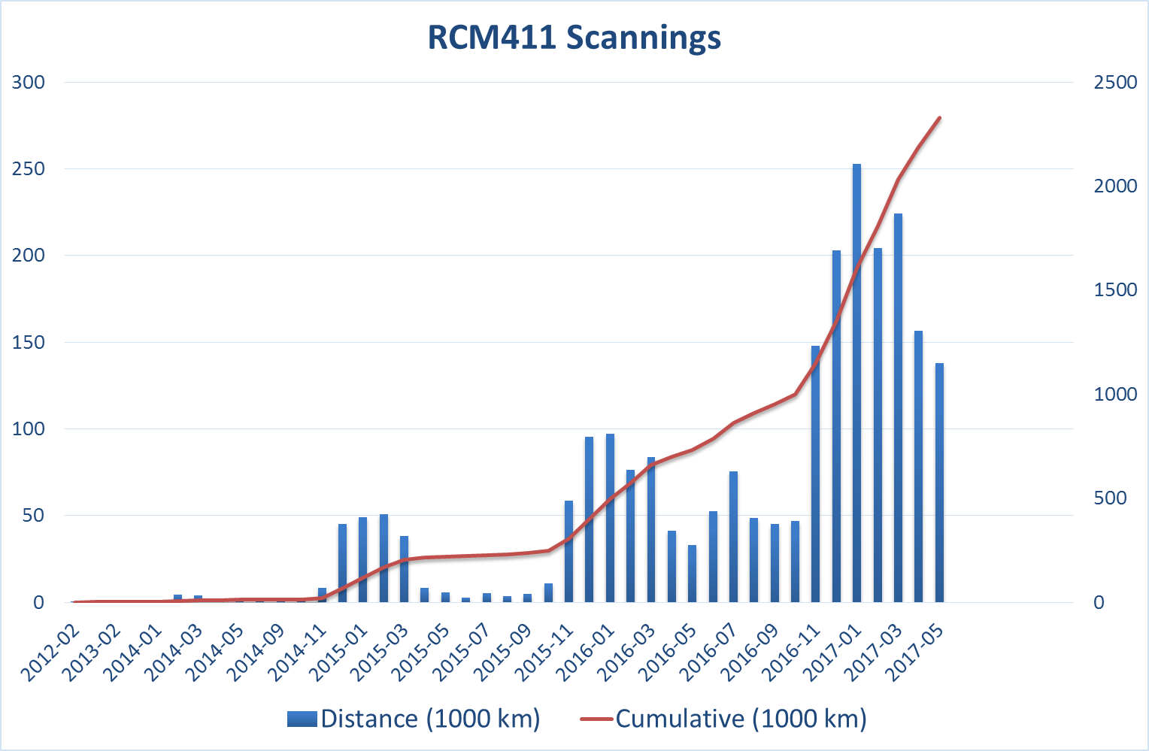

Slide 9
Data
https://keliapu.net/data
Date | Time(+00:00) | S1 | S2 | S3 | Friction | State | Ta | S7 | Tsurf | S9 | S10 | S11 | Water | Speed | Direction | Latitude | Longitude | Height | -Satellites | S19 | Friction2 | Distance | Serial(RCM411 V 2.59 2016-09-29 - RCM Embedded v1.5.2)
20.9.2017 | 15:55:07 | 35.87 | 32.5 | 0.195 | 0.81 | 1 | 11.6 | 267.2 | 11.54 | 997.8 | 644.9 | 1.104 | 0 | 21.8 | 274.1 | 60.34517 | 25.0239 | 45 | -18 |  |  | 304 | F77
20.9.2017 | 15:55:08 | 35.29 | 31.92 | 0.182 | 0.81 | 1 | 11.6 | 267.1 | 11.54 | 997.8 | 645 | 1.104 | 0 | 20.6 | 275 | 60.34518 | 25.02369 | 44 | -18 |  |  | 6 | F77
20.9.2017 | 15:55:09 | 36.61 | 33.15 | 0.183 | 0.81 | 1 | 11.6 | 266.9 | 11.53 | 999.4 | 645.8 | 1.104 | 0 | 20.7 | 274.9 | 60.34519 | 25.02359 | 44 | -18 |  |  | 12 | F77
20.9.2017 | 15:55:10 | 36.47 | 32.98 | 0.175 | 0.81 | 1 | 11.6 | 265.9 | 11.51 | 997.8 | 644.9 | 1.104 | 0 | 20.9 | 274.4 | 60.34519 | 25.02348 | 44 | -18 |  |  | 18 | F77
20.9.2017 | 15:55:11 | 37.27 | 33.66 | 0.184 | 0.81 | 1 | 11.6 | 267.8 | 11.56 | 999.2 | 645.8 | 1.104 | 0 | 21.3 | 274.4 | 60.3452 | 25.02338 | 44 | -18 |  |  | 24 | F77
20.9.2017 | 15:55:12 | 38.94 | 35.12 | 0.193 | 0.81 | 1 | 11.6 | 268.8 | 11.34 | 998.7 | 645.6 | 1.104 | 0 | 21.6 | 274 | 60.3452 | 25.02327 | 44 | -18 |  |  | 30 | F77
20.9.2017 | 15:55:13 | 40.5 | 36.58 | 0.198 | 0.81 | 1 | 11.6 | 271 | 11.31 | 997.7 | 645.1 | 1.104 | 0 | 22 | 274.1 | 60.3452 | 25.02315 | 45 | -18 |  |  | 36 | F77
20.9.2017 | 15:55:14 | 40.42 | 36.47 | 0.204 | 0.81 | 1 | 11.6 | 269.4 | 11.34 | 998.4 | 645.5 | 1.104 | 0 | 22.3 | 274.1 | 60.34521 | 25.02304 | 45 | -18 |  |  | 43 | F77
20.9.2017 | 15:55:15 | 39.29 | 35.48 | 0.2 | 0.81 | 1 | 11.6 | 270.6 | 11.16 | 997.8 | 645.3 | 1.104 | 0 | 22.5 | 274.3 | 60.34521 | 25.02293 | 45 | -18 |  |  | 49 | F77
20.9.2017 | 15:55:16 | 37.42 | 33.89 | 0.196 | 0.81 | 1 | 11.6 | 270.4 | 11.2 | 997.6 | 645 | 1.104 | 0 | 22.6 | 275.7 | 60.34522 | 25.02281 | 45 | -18 |  |  | 55 | F77
20.9.2017 | 15:55:17 | 38.91 | 35.22 | 0.206 | 0.81 | 1 | 11.6 | 270.3 | 11.43 | 998.8 | 645.8 | 1.104 | 0 | 22.6 | 275.7 | 60.34522 | 25.02281 | 45 | -18 |  |  | 62 | F77
20.9.2017 | 15:55:18 | 39.7 | 35.94 | 0.21 | 0.81 | 1 | 11.6 | 273 | 11.42 | 997.6 | 645.2 | 1.104 | 0 | 22.8 | 275.1 | 60.34523 | 25.02258 | 45 | -18 |  |  | 68 | F77
20.9.2017 | 15:55:19 | 42.52 | 38.57 | 0.229 | 0.81 | 1 | 11.6 | 273.6 | 11.13 | 996.8 | 644.5 | 1.104 | 0 | 22.8 | 275.1 | 60.34523 | 25.02258 | 45 | -18 |  |  | 74 | F77
20.9.2017 | 15:55:20 | 40.52 | 36.72 | 0.207 | 0.81 | 1 | 11.6 | 270.6 | 11.19 | 997.4 | 644.8 | 1.104 | 0 | 22.2 | 274 | 60.34524 | 25.02235 | 45 | -18 |  |  | 80 | F77
20.9.2017 | 15:55:21 | 36.94 | 33.63 | 0.185 | 0.81 | 1 | 11.6 | 269.2 | 11.57 | 997.5 | 644.8 | 1.104 | 0 | 21.6 | 273.7 | 60.34525 | 25.02224 | 45 | -18 |  |  | 86 | F77
20.9.2017 | 15:55:22 | 36.28 | 33.12 | 0.159 | 0.81 | 1 | 11.6 | 269.3 | 11.74 | 997.2 | 644.8 | 1.104 | 0 | 21.2 | 273.2 | 60.34525 | 25.02214 | 45 | -18 |  |  | 92 | F77
20.9.2017 | 15:55:23 | 37.95 | 34.6 | 0.15 | 0.81 | 1 | 11.6 | 270.9 | 11.49 | 997.8 | 645.1 | 1.104 | 0 | 20.9 | 273.3 | 60.34526 | 25.02203 | 45 | -18 |  |  | 97 | F77
20.9.2017 | 15:55:24 | 39.62 | 35.95 | 0.121 | 0.81 | 1 | 11.6 | 272.6 | 11.42 | 997.7 | 645 | 1.104 | 0 | 20.5 | 273.7 | 60.34526 | 25.02193 | 45 | -18 |  |  | 103 | F77
20.9.2017 | 15:55:25 | 39.94 | 36.12 | 0.087 | 0.81 | 1 | 11.6 | 272 | 11.4 | 997.7 | 645 | 1.104 | 0 | 19.6 | 273.9 | 60.34526 | 25.02183 | 45 | -18 |  |  | 108 | F77
20.9.2017 | 15:55:26 | 37.59 | 34.05 | 0.063 | 0.81 | 1 | 11.6 | 269.6 | 11.51 | 998.1 | 645.3 | 1.104 | 0 | 18.9 | 274.4 | 60.34527 | 25.02174 | 45 | -18 |  |  | 113 | F77
20.9.2017 | 15:55:27 | 40.12 | 36.37 | 0.062 | 0.81 | 1 | 11.6 | 271.8 | 11.75 | 997.7 | 645 | 1.104 | 0 | 18.5 | 274.6 | 60.34527 | 25.02164 | 45 | -18 |  |  | 118 | F77
20.9.2017 | 15:55:28 | 41.8 | 38.13 | 0.048 | 0.81 | 1 | 11.6 | 273.9 | 11.61 | 998.6 | 645.6 | 1.104 | 0 | 18.5 | 274.5 | 60.34527 | 25.02155 | 45 | -18 |  |  | 123 | F77
20.9.2017 | 15:55:29 | 41.91 | 38.18 | 0.026 | 0.81 | 1 | 11.6 | 272.7 | 11.38 | 997.5 | 644.9 | 1.104 | 0 | 18.5 | 274 | 60.34528 | 25.02145 | 45 | -18 |  |  | 129 | F77

Slide 10
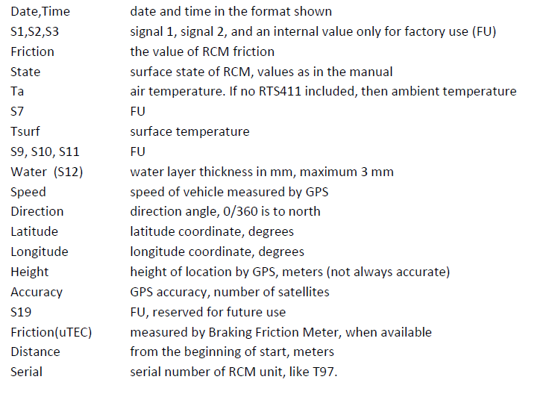
Data fields

Slide 11
Thank you!
roadweather.online

